Slide 1
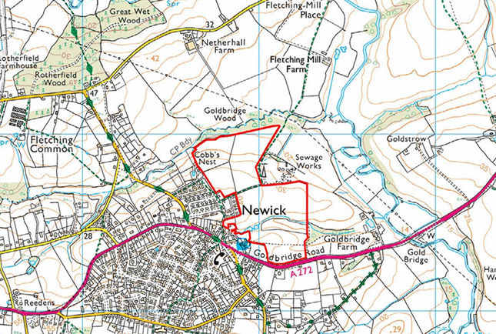
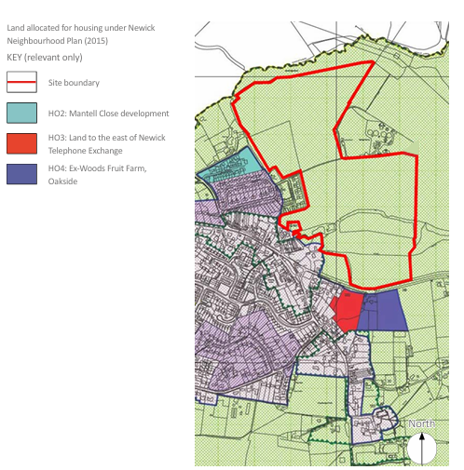
We are holding this meeting to ensure that we reflect your views when making our recommendation with reasons to LDC on Monday 12th May
Have your say…
Neighbourhood plan sites also have 40% affordable housing

Slide 2
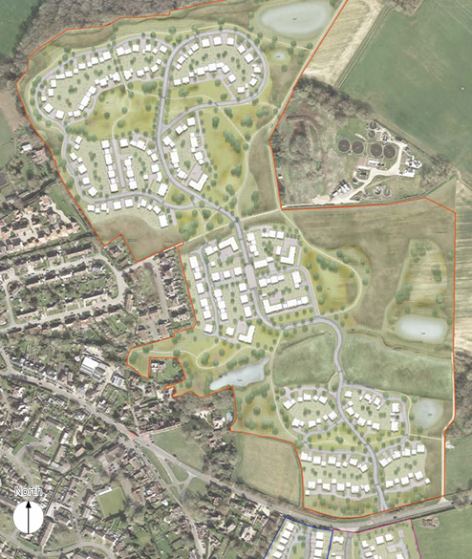
A brief overview of the application,
taken from the Design and Access statement
Application is for outline planning permission
27.5 hectares of farmland and woodland
A total of 250 1, 2, 3 and 4 bed dwellings, including 40% affordable (100)
Affordable homes, will be a mixture of rented and shared ownership, in line with local policy, and will be pepper-potted throughout the development and will be tenure blind.
3 play spaces 1 of which will be equipped
Vehicular access only from north side of A272 positioned slightly to the east of Berry Croft access to the south
The estate will be built in 7 stages starting with the access road and finishing with the houses in the north west of the site

Slide 3
What we know so far…
On 29th November 2023, NPC was given permission to conduct an exit poll at a Developer led consultation event for this site.
In 2.5 hours 272 local residents attended. Only 7 supported the development.
Many attendees made comments and were invited to e mail NPC with their comments. 64 very detailed emails of objection were received from residents.
On the LDC planning portal comments on this application have flooded in – By Thursday this was the current situation. Out of a total 100 responses ;
  42 were supporting the development of which 24 live well outside of the village and 15 of the responses contained no comments
  58 objections were received all from Newick and surrounding area and all contained comments

Slide 4
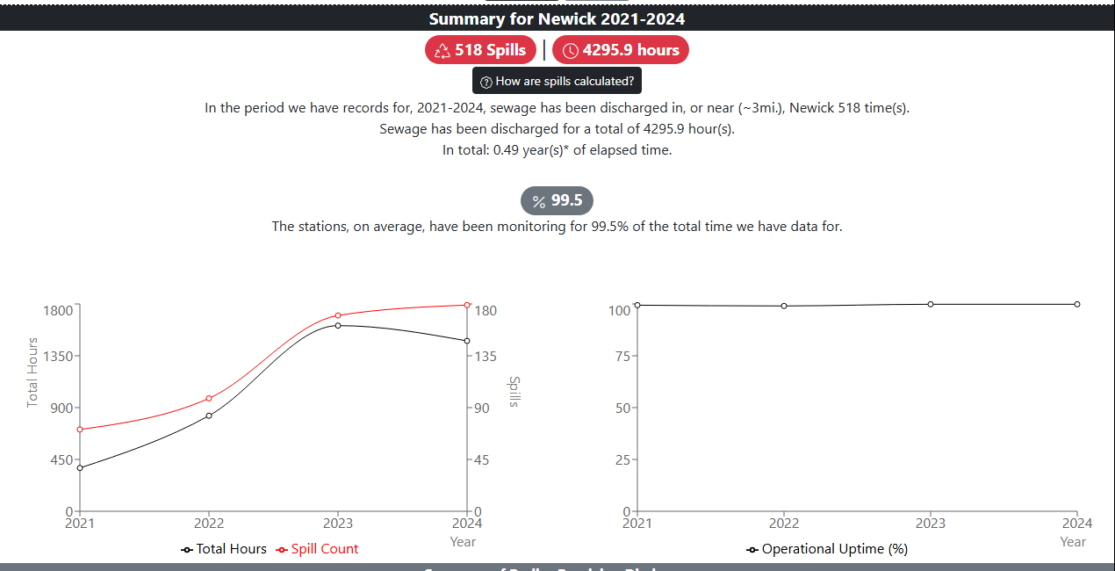
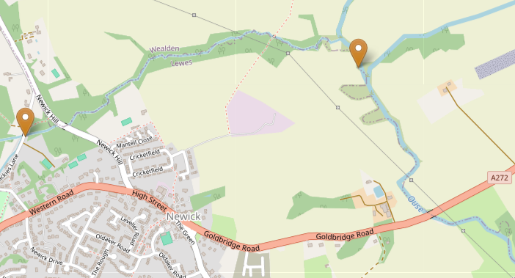
Some facts which may help you in decision making – NPC must not predetermine any application
The current situation with sewage……………

Slide 5
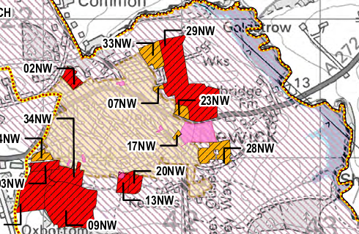
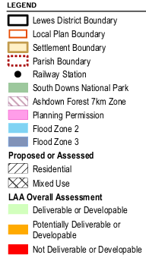
The Current Land Availability Assessment
We are assured that the whole site is not in the emerging local plan……………..

Slide 6
Brief reasons why LDC classified it red
Not deliverable or developable
A visually sensitive location due to open views to the north and is adjacent to The Green Conservation Area.
Development would extend into the countryside detracting from the character of the village with a number of Listed Buildings within the Conservation Area.
Site is assessed to be of high-medium sensitivity to large scale residential development detracting from the contained nucleated character of Newick and would conflict with the existing settlement pattern and development could cause undue harm to the landscape.
Section of site is recorded as historic landfill, and adjacent to sewage works, impacts of both would need to be considered.
Multiple records of statutory and notable species on and around the site. Existing trees, woodland and hedgerows likely to accommodate habitats. There is a significant area of tree planting on the site. Adjacent woodland to the east is designated Ancient Woodland as is Goldbridge Wood to the north of the site.
These reasons have been given additional weight since changes to the NPPF December 2024

Slide 7
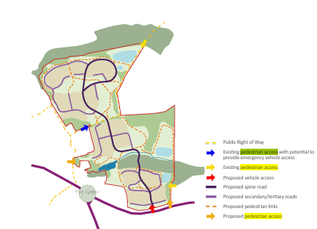
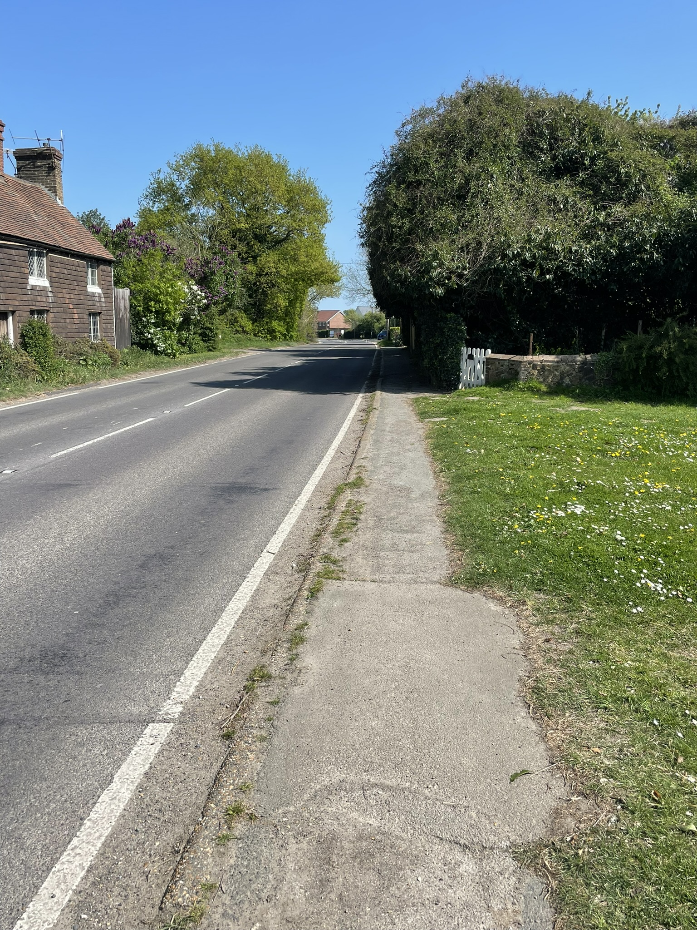
Pedestrian access from the site to anywhere in the village
Pedestrian access to the site is located at Alexander Mead, on the western boundary and at the north of the site from Goldbridge Wood via an existing PRoW, NWK/10/1

Slide 8
Affordable housing in Newick – shared equity
From April 2025 minimum wage will be £12.21. If working 37 hours per week and contributing 5% to a pension this gives a net salary of £1624.52 per month. This does not include any child benefit, working families tax credit etc.
A couple both working full time on minimum wage with no childcare costs or student loan would have a joint income of £3248.04
Stonewater is the Thakeham Shared ownership provider. A property with a market value of £510,000 which would be a larger 2 bed or a smaller 3 bed new build in Newick works out as the following;
40% share purchased at £204,000. Would need at least a 5% deposit (£10,200) and a mortgage of £193,800.
Assuming an interest rate of 5% (which is what you would expect for a 95% mortgage 2 or 5 year fixed). 25 years repayment would be £1133 per month.
The rent on the remaining 60% is £701.25 per month.
Service charge is variable but on current Stonewater builds is £93 per month for a £510,000 property.
So that is £1927 per month combined before paying Council tax, utilities, food, transport. Childcare etc

Slide 9
Current Affordable housing in Newick
Private rental market….A three bed semi on the estate in Newick is about £1695 pcm
The 'Rent to Buy' version of affordable homes with Stonewater offer properties at 80% of market rental for 5 years. The idea is that the remaining 20% you save and then after 5 years you use that as a deposit to buy the house. The onus is on the renter to save the 20% which will be tricky for some people. Therefore a similar Affordable rental property in Newick would be about £1356 pcm
An affordable one bedroom flat would be about £880 pcm with an annual review of rent to reflect the private market increase or decrease
Social rent in Newick is approximately £400pcm for a 1940’s 2 bedroom flat, about £600 for a 3 bedroom 1940’s house, £598 for a 1960’s 2 bedroom house and about £770 for a 1980’s 2 bedroom dwelling with assisted living.
The emerging local plan affordable housing policy includes a ‘Viability test’ (developers must be allowed to make 20% profit). It could mean total affordable housing allocation is not in Newick and has no or very few social rents.

Slide 10
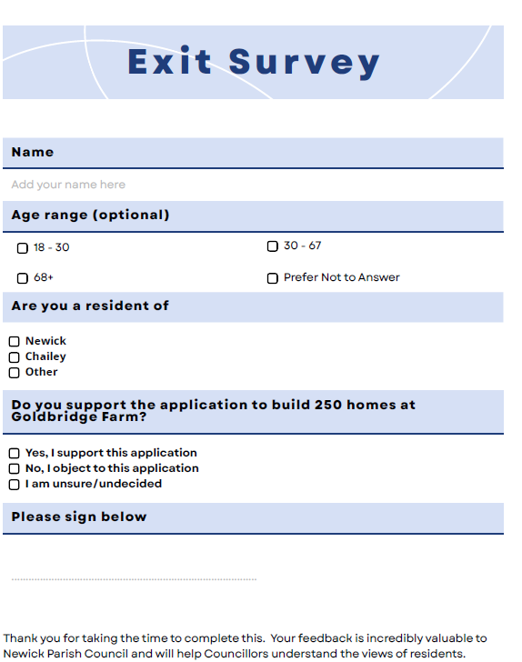
Thank you for coming … now its time for your questions and comments
Please don’t forget to complete our exit survey

